Slide 1

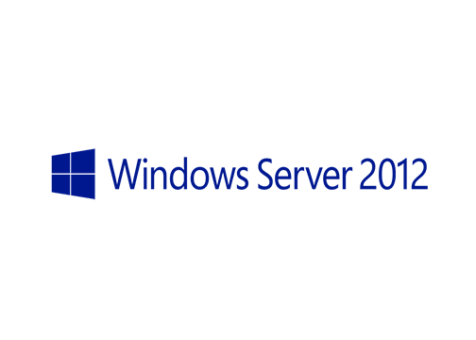
MegaSeries
Central SSL cert store and SNI

Slide 2
Intro
New features in Windows Server 2012
These features have been introduced in the context that Windows Server 2012 is a cloud-ready OS

Slide 3
SNI
In past operating systems a certificate could be linked to a unique ip:port combination (one IP per SSL site)
Now the full hostname of the website is also used so the same IP and port can be used for 2 or more HTTPS sites
Pre 2012 when accessing a site all certs installed on that server would be loaded in memory
Now every cert is loaded on demand upon accessing a site

Slide 4
Central SSL cert store
A file share can be used to store SSL certificates and one or more web servers can access this share
No need to import a certificate on many servers if they are part of a web farm as they have the certs easily accessible in the SMB share and load them on demand

Slide 5
https://www.youtube.com/channel/UCcZ-jLbPwNr8E_v9-65n8Iw https://github.com/itknowledge4

